Slide 1

DATA SCIENCE
10 WEEK PART TIME COURSE
Model Evaluation and Optimisation

Slide 2
AGENDA
Evaluating machine learning models
Why is this important?
Splitting off test sets
Being even

Slide 3
Over-fitting, under-fitting and other errors
DATA SCIENCE PART TIME COURSE

Slide 4
Supervised Learning Challenges
Type of error | Cause | Example
Bias | The model doesn’t capture the necessary variables | Linear model trying to model exponential growth
Variance | Over-fitting: the model responds to noise and outliers | Outlier that makes a linear model look exponential
Irreducible | There is randomness in the data | Predicting someone’s surname from their first name

Slide 5
TRAINING ERROR
Q: What’s wrong with training error?
Thought experiment:
Suppose we train our model using the entire dataset.
Q: How low can we push the training error?
We can make the model arbitrarily complex (effectively “memorizing” the entire training set).
A: Down to zero!

Slide 6
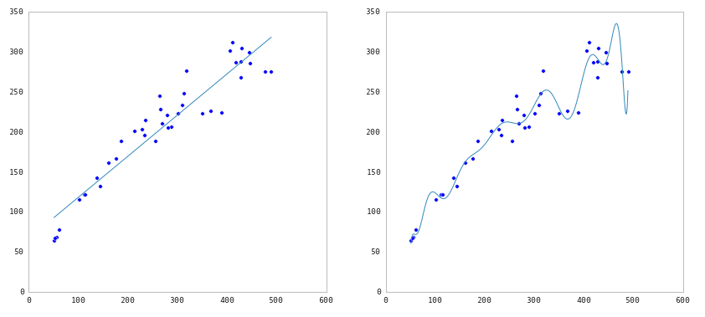
TRAINING ERROR

Slide 7
TRAINING ERROR
Q: What’s wrong with training error?
Thought experiment:
Suppose we train our model using the entire dataset.
Q: How low can we push the training error?
We can make the model arbitrarily complex (effectively
“memorizing” the entire training set).
A: Down to zero!
A: Training error is not a good estimate of
accuracy beyond training data.

Slide 8
TRAINING ERROR
Why this matters
The data that we are given for prediction won’t always be the end of the data we are interested in! We may not have access to all the data of interest
We will gather data and build and iterate over models however a main reason for building the model was to predict unseen test cases.

Slide 9


TEST SET APPROACH
Q: How can we make a model that generalizes well?
model
dataset

Slide 10
TEST SET APPROACH
Q: How can we make a model that generalizes well?
1) split dataset
model
dataset

Slide 11

TEST SET APPROACH
Q: How can we make a model that generalizes well?
1) split dataset
2) train model
training set
model
dataset

Slide 12

TEST SET APPROACH
Q: How can we make a model that generalizes well?
1) split dataset
2) train model
3) test model
training set
model
test set
dataset

Slide 13
TEST SET APPROACH
Q: How can we make a model that generalizes well?
1) split dataset
2) train model
3) test model
4) parameter tuning
training set
model
test set
dataset

Slide 14
TEST SET APPROACH
Q: How can we make a model that generalizes well?
1) split dataset
2) train model
3) test model
4) parameter tuning
5) choose best model
training set
model
test set
dataset

Slide 15
TEST SET APPROACH
Q: How can we make a model that generalizes well?
1) split dataset
2) train model
3) test model
4) parameter tuning
5) choose best model
6) train on all data
training set
model
test set
dataset

Slide 16

TEST SET APPROACH
Q: How can we make a model that generalizes well?
1) split dataset
2) train model
3) test model
4) parameter tuning
5) choose best model
6) train on all data
7) make predictions
on new data
training set
model
test set
new data
dataset

Slide 17

TEST SET APPROACH
Q: How can we make a model that generalizes well?
1) split dataset
2) train model
3) test model
4) parameter tuning
5) choose best model
6) train on all data
7) make predictions
on new data
NOTE
This new data is called out of sample data. We don’t know the labels for these OOS records!
We want to estimate OOS prediction error so we know what to expect from our model.
training set
model
test set
new data
dataset

Slide 18
CODING IT…
X = DF[[“Column1”,”Column2”…]]
Y = DF[[“Other column”]] from sklearn.cross_validation import train_test_split
import sklearn.metrics
(X_train, X_test, y_train, y_test) = train_test_split(X, y,
test_size=0.1)
Predictor.fit(X_train, y_train)
Y_predict = Predictor.predict(y_train)
print sklearn.metrics.accuracy_score(y_test, Y_predict)

Slide 19
THE CLASSIFIER YOU HAVE TO OUT-PERFORM
from sklearn.dummy import DummyClassifier
dumb = DummyClassifier(strategy='most_frequent')
dumb.fit(X_train, y_train)
y_dumb_class = dumb.predict(X_test)
print sklearn.metrics.accuracy_score(y_test, y_dumb_class)

Slide 20
LAB
DATA SCIENCE PART TIME COURSE

Slide 21
K-folds
DATA SCIENCE PART TIME COURSE

Slide 22
TEST SET APPROACH
Suppose we do the train/test split.
Q: How well does test set error predict OOS?
Thought experiment:
Suppose we had done a different train/test split.
Q: Would the test set error remain the same?
A: Of course not!
A: On its own, not very well.

Slide 23
TEST SET APPROACH
TEST SET APPROACH
Suppose we do the train/test split.
Q: How well does test set error predict OOS?
Thought experiment:
Suppose we had done a different train/test split.
Q: Would the test set error remain the same?
A: Of course not!
A: On its own, not very well.
NOTE
The test set error gives a high-variance estimate of OOS accuracy.

Slide 24
TEST SET APPROACH
Something is still missing!
Q: How can we do better?
Thought experiment:
Different train/test splits will give us different test set errors.
Q: What if we did a bunch of these and took the average?
A: Now you’re talking!
A: Cross-validation.

Slide 25
CROSS VALIDATION
Steps for K-fold cross-validation:
Randomly split the dataset into K equal partitions.
Use partition 1 as test set & union of other partitions as training set.
Calculate test set error.
Repeat steps 2-3 using a different partition as the test set at each iteration.
5) Take the average test set error as the estimate of OOS accuracy.

Slide 26
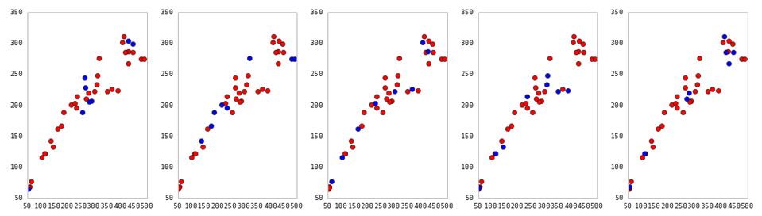
CROSS VALIDATION
5-fold cross-validation: red = training folds, blue = test fold
Source: http://nbviewer.ipython.org/github/fonnesbeck/Bios366/blob/master/notebooks/Section6_3-Model-Selection-and-Validation.ipynb

Slide 27
CROSS VALIDATION
Features of K-fold cross-validation:
More accurate estimate of OOS prediction error.
More efficient use of data than single train/test split. - Each record in our dataset is used for both training and testing.
Presents tradeoff between efficiency an computational expense. - 10-fold CV is 10x more expensive than a single train/test split
Can be used for parameter tuning and model selection.

Slide 28
Slightly interactive session
DATA SCIENCE PART TIME COURSE

Slide 29
K-FOLD Code (the manual way)
from sklearn.cross_validation import KFold
DF = pandas.from_csv(…)
X = DF[[…]]
y = DF[[…]]
Number_of_rows = len(DF)
for fold in KFold(Number_of_rows, n_folds=10):
train_fold = fold[0]
test_fold = fold[1]
X_fold = X[train_fold]
y_fold = y[train_fold]
classifier = sklearn.classifier.FavouriteClassifier()
classifier.fit(X_fold, y_fold)
predictions = classifier.predict(X[test_fold])
print accuracy_score(y[test_fold], predictions)

Slide 30
K-FOLD Code (automatic)
from sklearn.cross_validation import cross_val_score
DF = pandas.from_csv(…)
X = DF[[…]]
y = DF[[…]]
classifier = sklearn.classifier.FavouriteClassifier()
cross_val_score(classifier, X, y, cv=10, scoring=‘accuracy’)
Run the for loop of a KFold
Can be a function.
Strings have hard-coded meanings. E.g. ‘accuracy’ says to use
sklearn.cross_validation.accuracy_score()
n_folds parameter

Slide 31
LAB
DATA SCIENCE PART TIME COURSE

Slide 32
Variations you should know about
StratifiedKFold
Make sure there are similar numbers of target labels in each fold
LabelKFold
Make sure each label isn’t in the source set

Slide 33
Brute force search for the best
DATA SCIENCE PART TIME COURSE

Slide 34
Models often have weights and parameters
K-means | Number of clusters
DBScan | Density / radius
Decision tree | Depth / Gini vs Entropy / Max Features
RANSAC | Path width
How can we automate trying lots of different options to find the best set?

Slide 35
sklearn.grid_search.GridSearchCV
Inputs:
estimator (e.g. sklearn.tree.DecisionTreeClassifier)
param_grid (a dictionary of lists)
scoring (optional: a string or function as per cross_val_score)
cv (optional: how many StratifieldKFold splits, or equivalent)
Outputs:
grid_scores_
(parameter, mean_score, per-fold scores)
best_estimator_
best_score_
best_params_

Slide 36
In code
import sklearn.tree, sklearn.grid_search, pandas
DF = pandas.from_csv(…)
Params = {’max_depth’: range(1,10),
’criterion’=[’gini’, ’entropy’],
’max_features’ : range(1,5)}
Classifier = sklearn.tree.DecisionTreeClassifier()
BruteForce = sklearn.grid_search.GridSearchCV(
estimator=Classifier,
param_grid=Params,
cv=5)
BruteForce.fit(DF[[sourcecolumns…]], DF[[destcolumn]])
print BruteForce.best_params_, BruteForce.best_score_

Slide 37
LAB
DATA SCIENCE PART TIME COURSE

